Slide 1

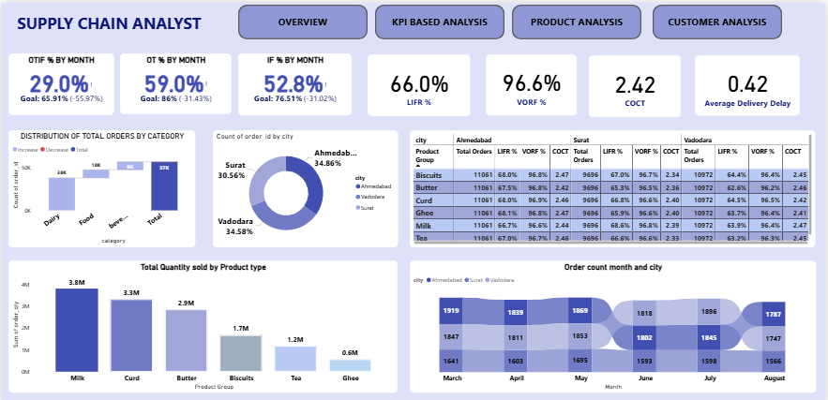
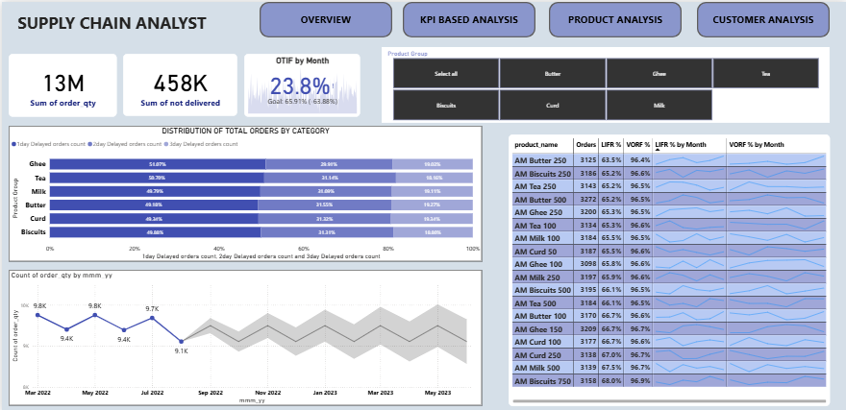
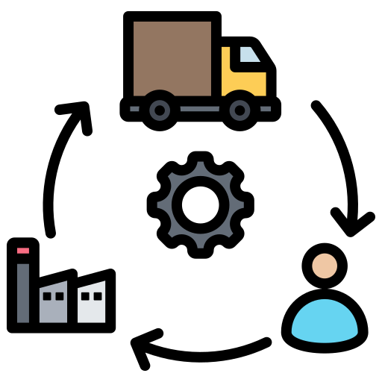
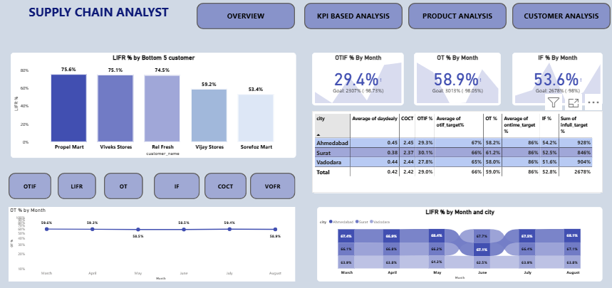
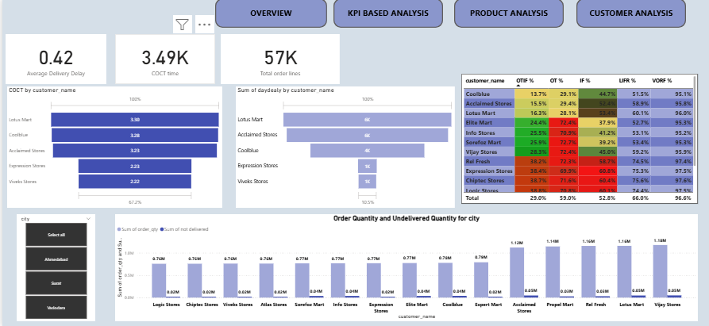
Supply Chain Service Level Data Analysis– AtliQ Mart
This dashboard monitors supply chain performance with KPIs and detailed analysis.

Slide 2
Company: AtliQ Mart – FMCG manufacturer based in Gujarat, India
Current Operations: Surat, Ahmedabad, Vadodara
Future Goal: Expand to Tier-1 cities within 2 years
Problem Statement:
Some key customers did not renew contracts due to service issues
Essential products were delivered late or incomplete
Risk of losing customers & reputation before expansion
Objective:
Track On-Time (OT %), In-Full (IF %), and On-Time In-Full (OTIF %) delivery daily
Compare service levels against customer targets
Provide insights to improve customer service & retention

Slide 3
Dairy and Beverages dominate order count.
VOFR is strong across cities, but LIFR lags → supply issues are about completeness, not volume.
Orders are fairly balanced across three cities, Ahmedabad slightly higher.
Dairy products dominate sales volume
Order volume is stable month-to-month, but distribution varies slightly by city

Slide 4
The lowest service levels are concentrated in Vijay Stores & Sonofaz Mart, which require priority action.
Ahmedabad is driving performance, but Surat is dragging overall metrics
All KPIs remain flat with no month-on-month recovery. OT and IF are significantly below targets, pulling OTIF down. While costs are stable, efficiency and reliability are the key challenges
Ahmedabad is stable and leading, but other two cities are reducing overall LIFR.

Slide 5
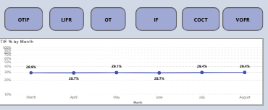
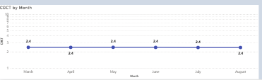
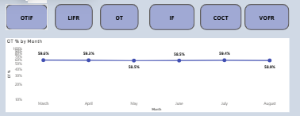
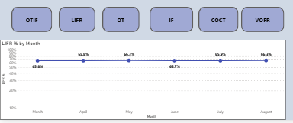
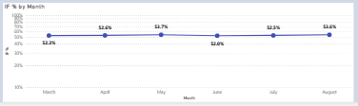

OTIF % by Month
Performance is consistently low (28–29%).
No visible improvement from March to August.
Insight: Major structural issue in on-time and in-full deliveries
COCT (Cost of Order Cycle Time) by Month
Stable at 2.4 across all months.
Insight: Cost is consistent → issue is efficiency/output, not cost escalation
OT % by Month
Flat trend at ~58–59%.
Far below target of 96%, no recovery visible.
Insight: Biggest weakness, showing lack of process control in timely delivery.
LIFR % by Month
Fluctuates between 65.8% – 66.3%.
Stable but consistently below target (76.5%).
Insight: Some consistency exists, but the level is inadequate
IF % by Month
Moves around 52–53%, with slight dips (lowest in June: 52.0%).
Remains well below goal (86%).
Insight: Inventory or order fill challenges are persistent
VOFR % by Month
Stays very high and stable (~96–97%) across months.
Close to the goal (97%), showing good performance.
Compared to OTIF, OT, IF: VOFR is the only KPI consistently on track

Slide 6
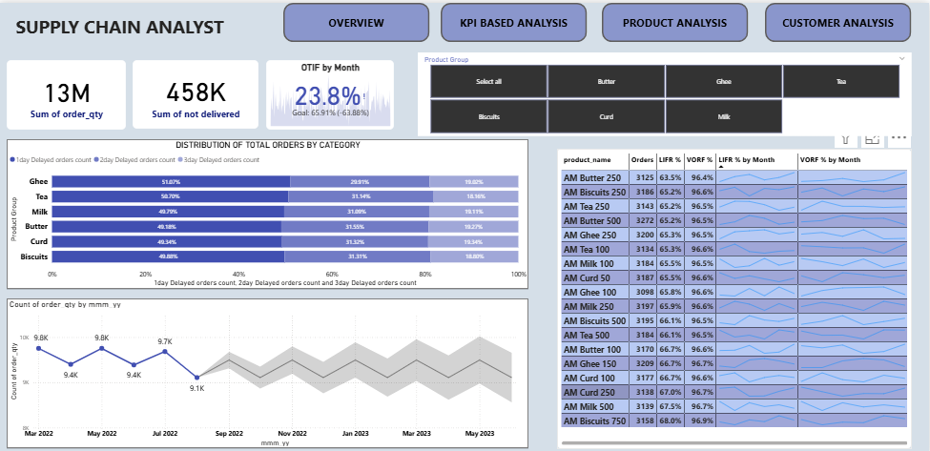
All product groups suffer delays, but Biscuits & Curd stand out as the worst affected categories.
Volume fulfillment is good, but line-item fill (LIFR) is weak — especially for Tea, Ghee, and Butter.
Demand stability → problem is purely supply chain execution, not demand fluctuation
Products are being shipped in correct volumes, but delays (timeliness) and incomplete orders reduce OTIF.
Product supply chain is facing severe timeliness and completeness issues, with OTIF only 23.8%. While order volumes (VOFR) remain strong at 96%, categories like Biscuits and Curd face the highest delays, and products such as Tea, Ghee, and Butter show weak LIFR performance.

Slide 7
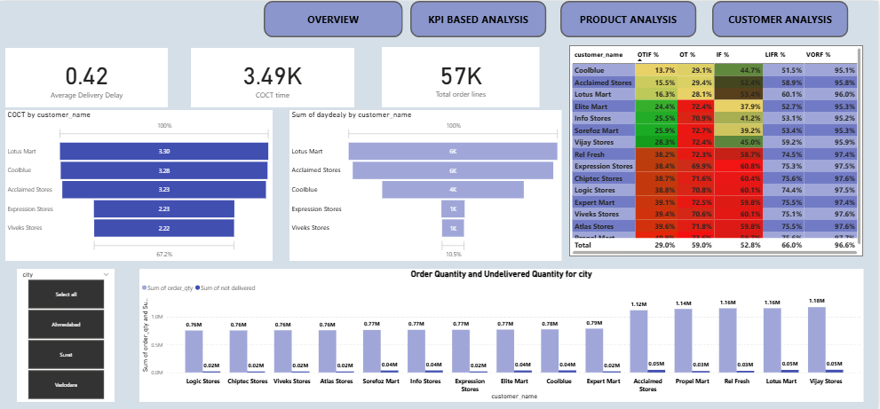
Large modern trade outlets face the longest processing times, while smaller stores get quicker processing.
Modern trade chains (Coolblue, Lotus, Acclaimed) → worst OTIF & LIFR. Smaller retailers → better service.
Key modern trade customers (Lotus, Acclaimed, Coolblue) face maximum delays → high service risk on strategic clients
High-demand cities (Logic, Chiptec, Vivek) are most affected by undelivered quantities → biggest volume risk
Customer service is highly inconsistent. Modern trade clients (Lotus, Coolblue, Acclaimed) suffer from maximum delays and the lowest OTIF (as low as 19–27%), while smaller retailers perform relatively better. Although VOFR remains strong at ~96%, the main issue lies in timeliness and completeness, with top-volume customers (Logic, Chiptec, Vivek) experiencing the highest undelivered quantities

Slide 8
Thank
You

